Slide 1
AI and ML in Astronomy application
Satyapriya Das and Aniket Prasad*

Slide 2
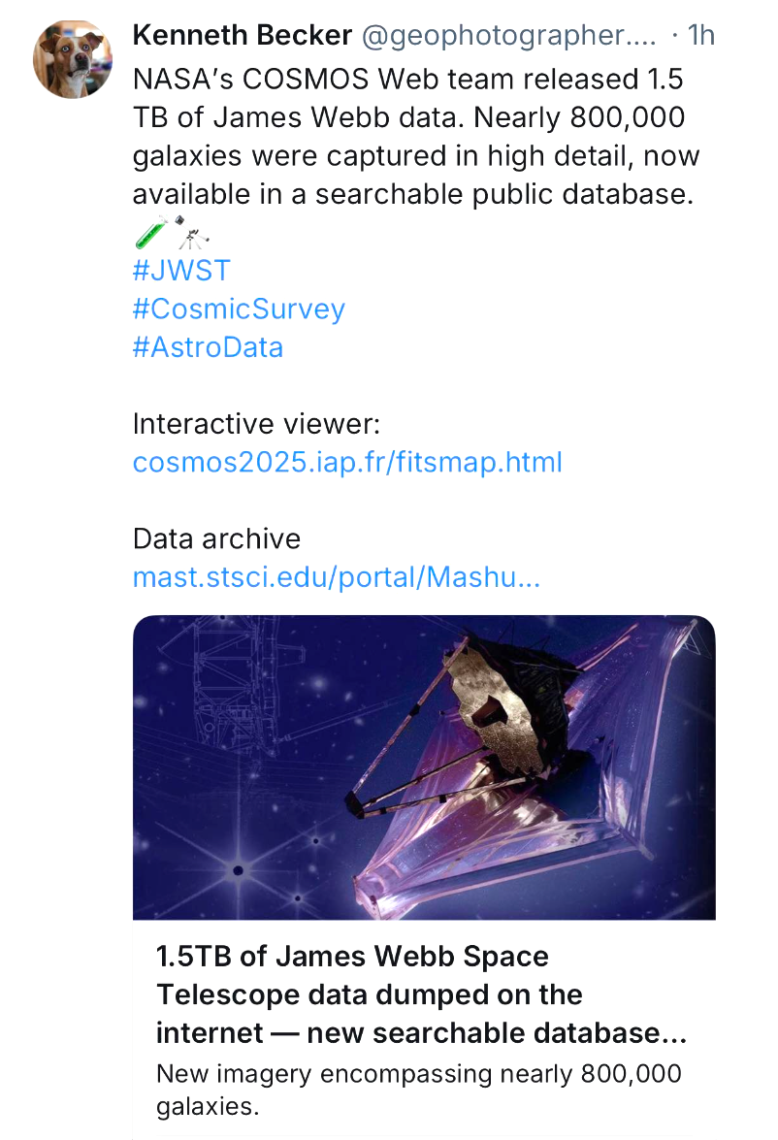
The Big Data Challenge in Astronomy
Modern telescopes produce massive data.
SKA will generate 600 PB per year.
SDSS has over 500 million objects cataloged.
Traditional analysis isn’t scalable — AI steps in.

Slide 3
Why Automate?
Manual inspection isn’t practical for modern datasets.
Machine Learning automated
pattern recognition,
classification, and
predictions.
Helps discover rare or subtle phenomena missed by humans.

Slide 4
Categories of ML
Supervised — Labelled data (e.g. galaxy morphology classification)
Semi-supervised — Small labelled + large unlabeled data (common in astronomy)
Unsupervised — No labels (e.g. clustering quasars)

Slide 5
ML Problems in Astronomy
Classification
Categorising objects
Identifying objects of similar types
Regression
Predicting continuous values
Based on input, find expected quantified values

Slide 6
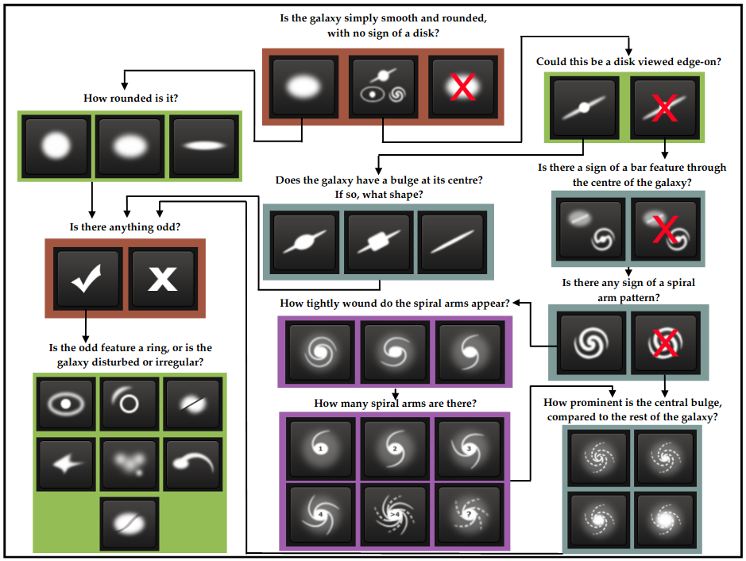
Classification Example - Galaxy Morphology
Refer to this awesome page:
https://jayspeidell.github.io/portfolio/project07-galazy-zoo/

Slide 7
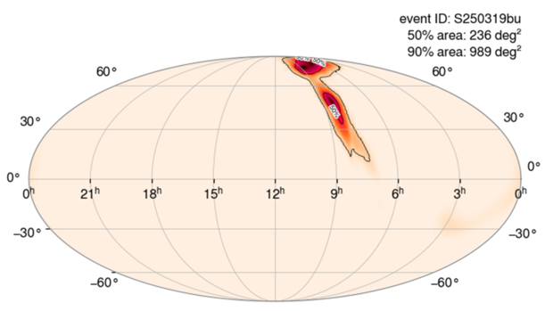
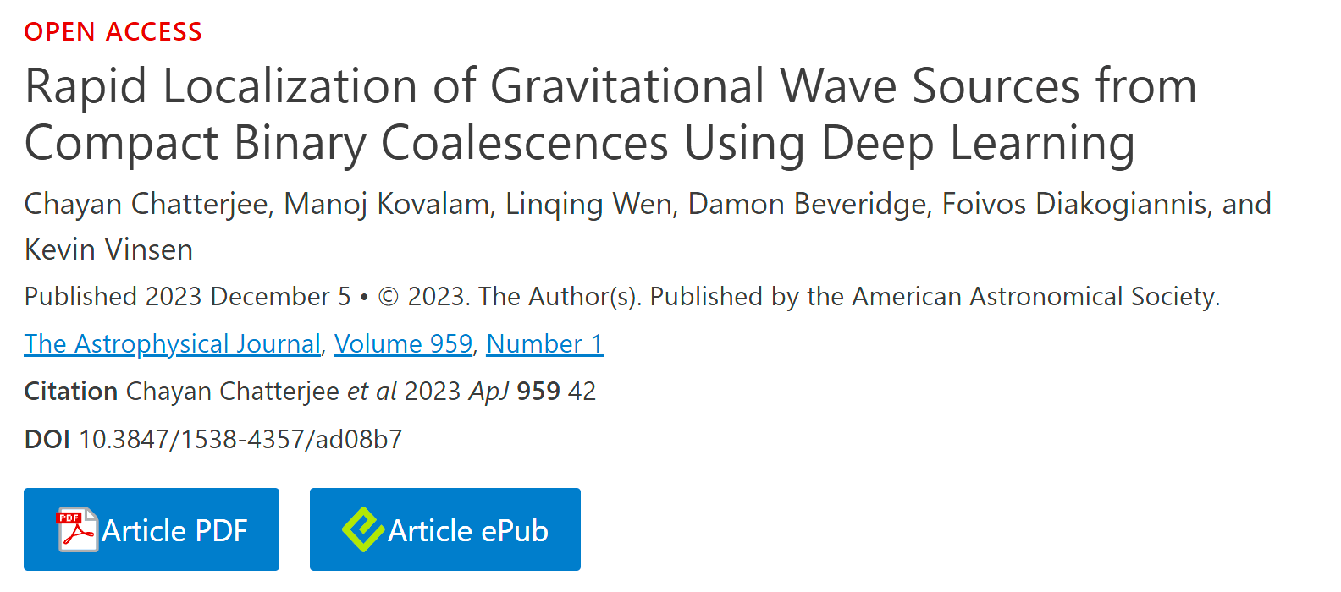
Regression Example
Redshift prediction from spectra
Gravitational Wave event localization

Slide 8
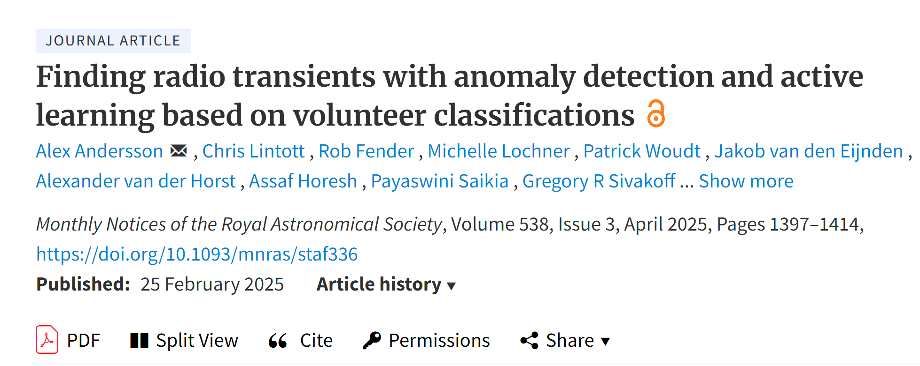
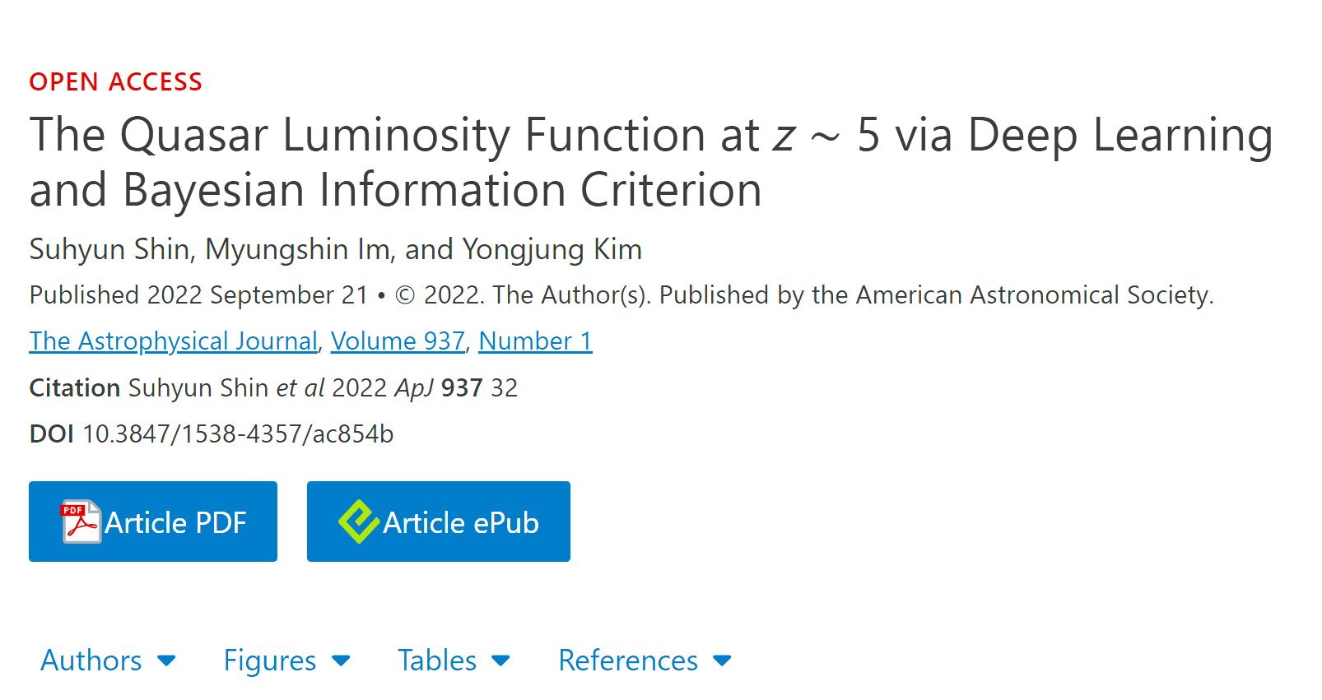
Deep Learning — The Next Frontier
SKA’s massive raw data needs deep learning pipelines for reduction.
AI on processed science data:
Identifying gravitational lenses
Predicting occurrence rates
Unveiling faint or rare signals

Slide 9
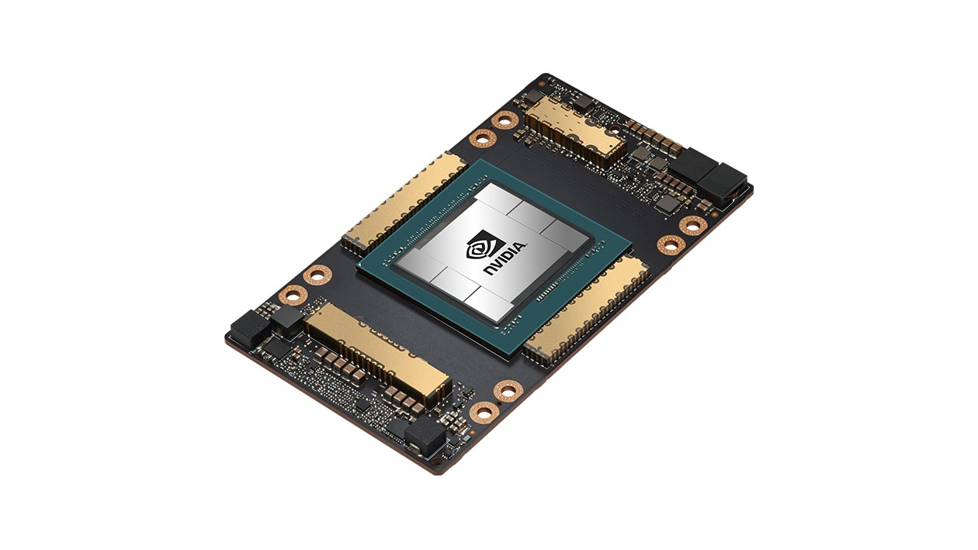
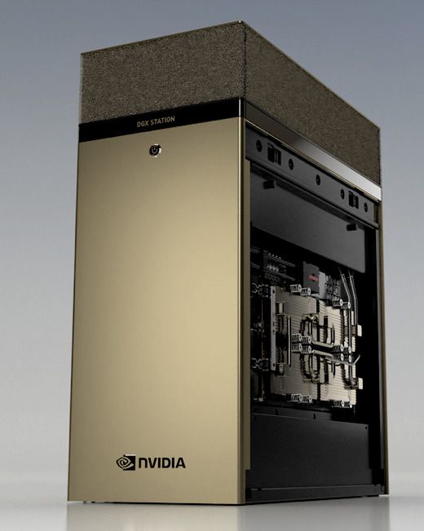
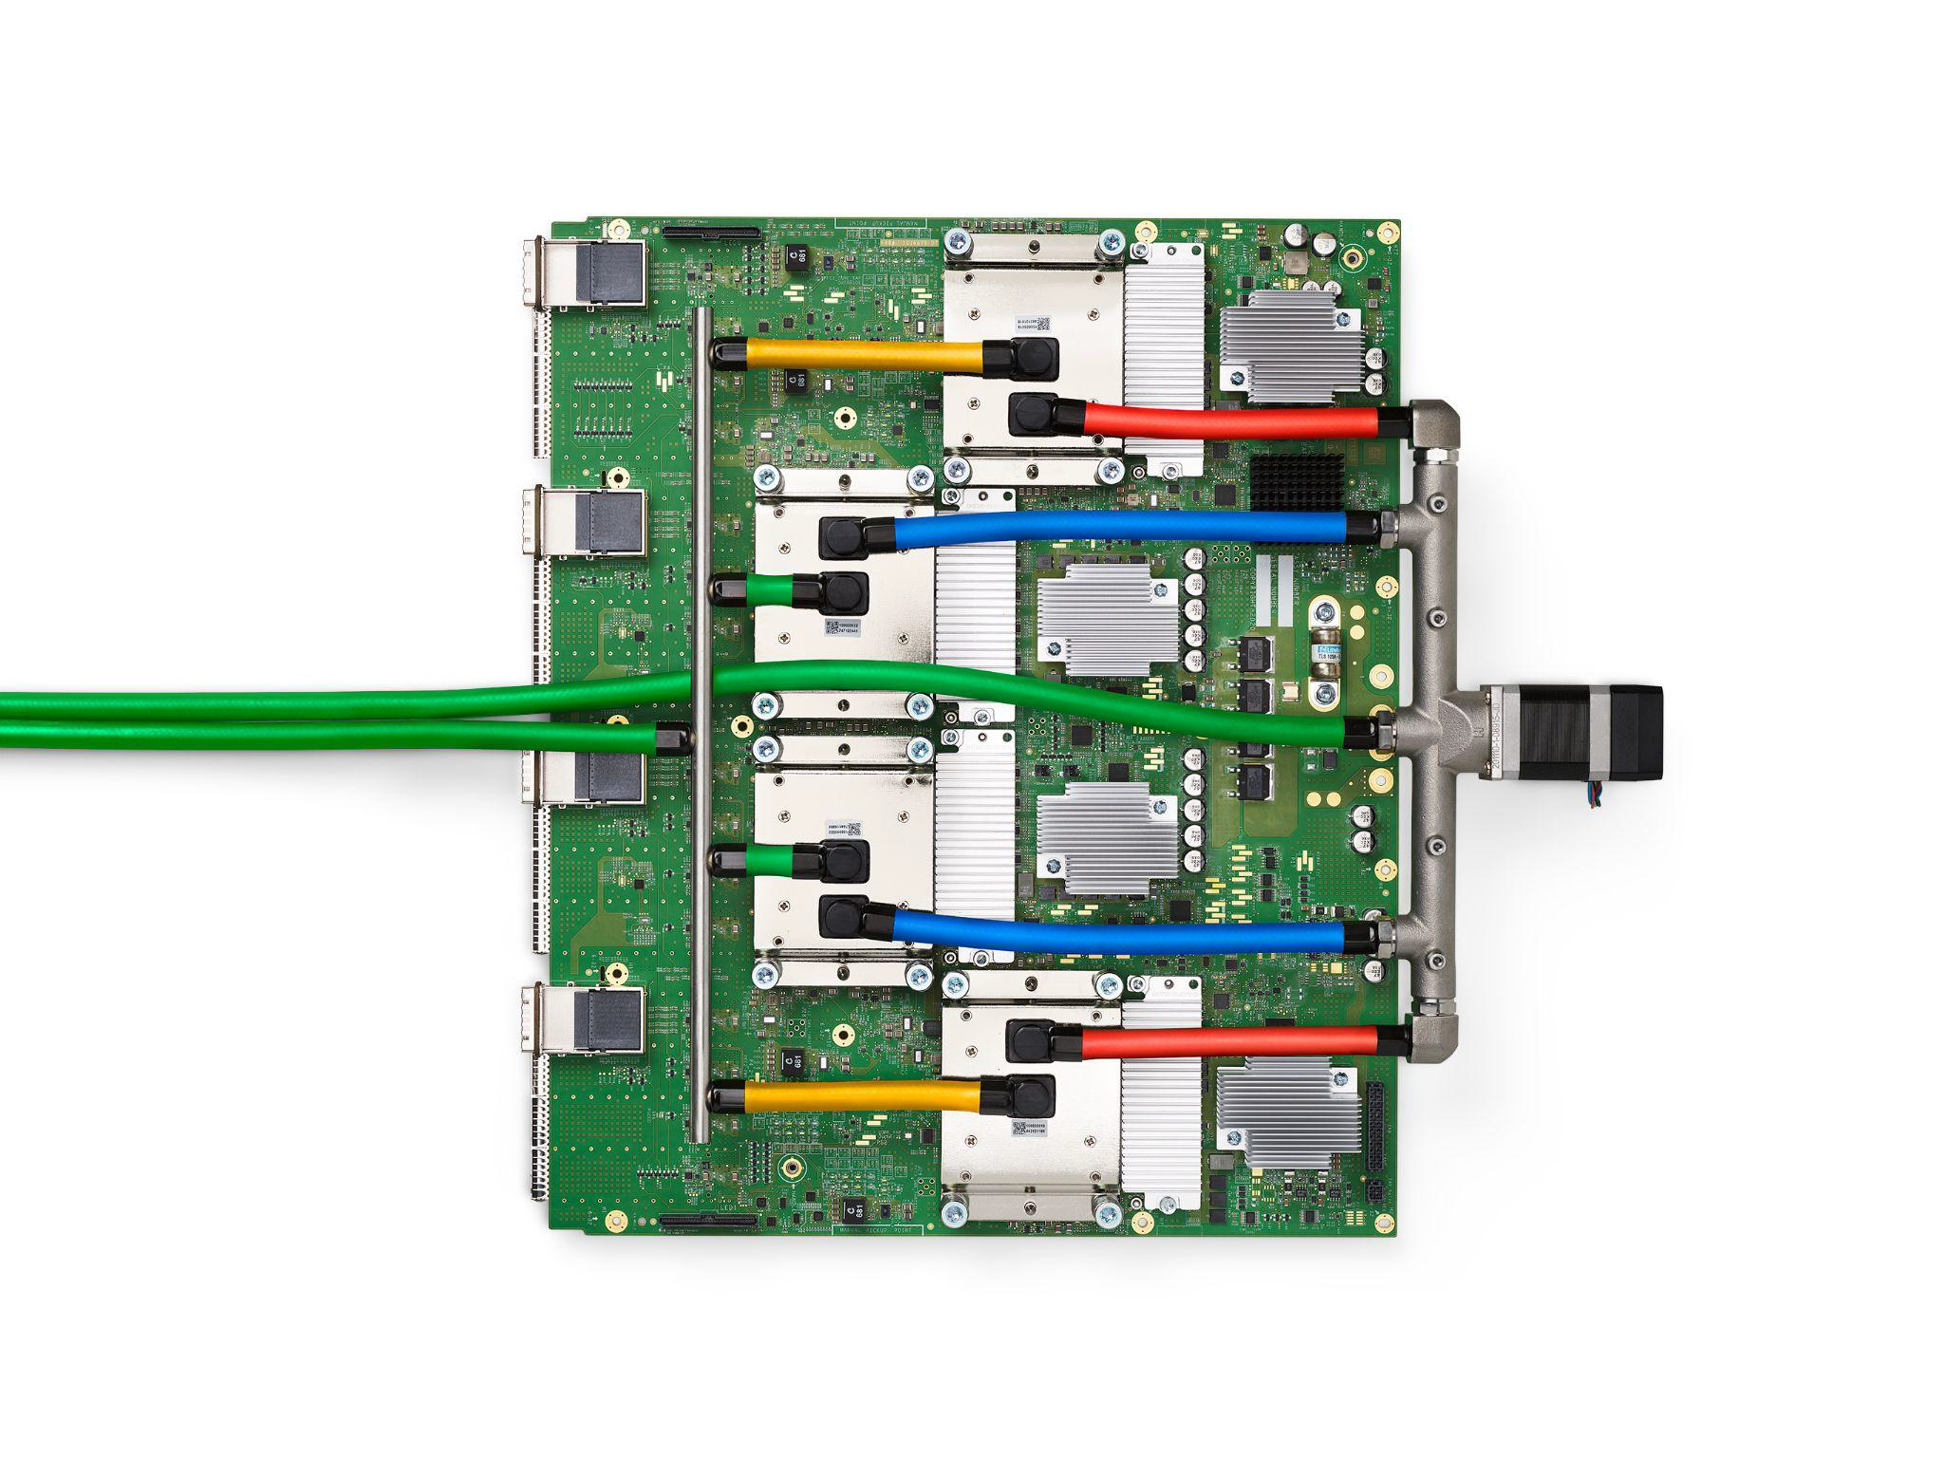
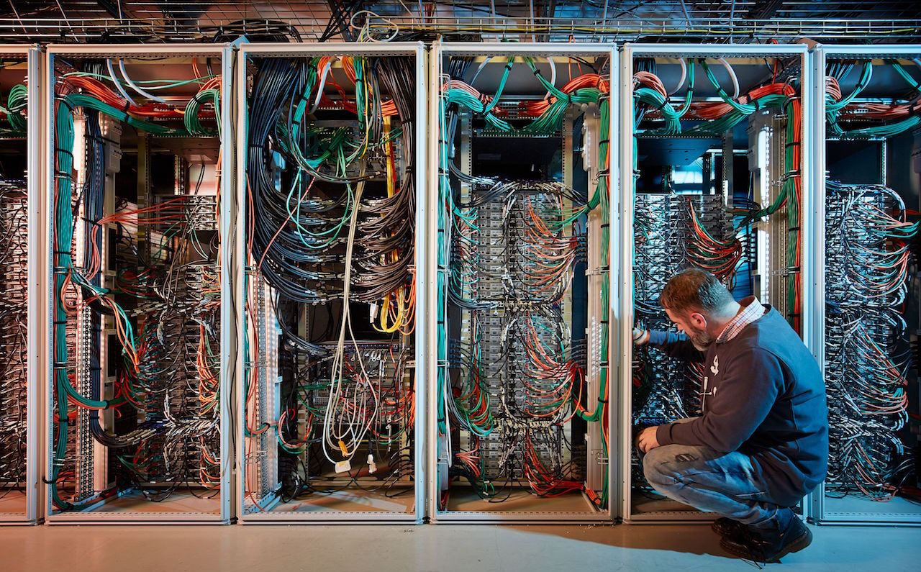
Powerful Hardware for ML and DL - NOT PCs
Why hardware matters:
AI/ML models, especially Deep Learning, require processing millions of parameters over massive datasets. Specialized hardware speeds this up drastically.
NVIDIA A100 GPU
40–80 GB memory
Up to 312 TFLOPS (Tensor operations)
Trains large models like GPT, ResNet in hours, not days
Used in SKA prototype pipelines and astronomy deep learning research
NVIDIA DGX Station A100
4x A100 GPUs
320 GB GPU memory total
Over 2,000 TFLOPS (Tensor) in a desktop-sized machine
Used by institutions like NASA and ESO for AI in data reduction
Google TPU v4
4x faster than A100 for matrix-heavy operations
275 TFLOPS per chip
Highly efficient for training huge neural networks like those for SKA raw data handling
SKA Regional HPC Clusters (Planned)
Capable of handling 600 PB/year
Equipped with multi-GPU, AI accelerators
Real-time data processing for transient detection (e.g., FRBs, GW counterparts)

Slide 10
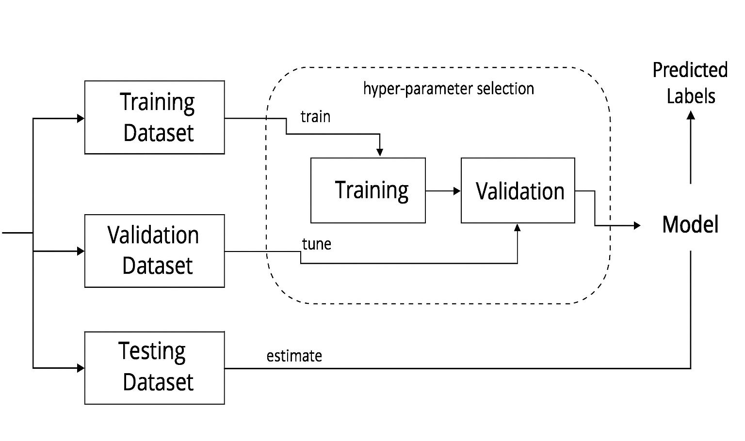
Basic Machine Learning Workflow
Raw Data
Feature and Labels

Slide 11





ML Tools for Astronomers
Scikit-learn — Classic ML models
TensorFlow / PyTorch — Deep learning frameworks
Specialized libraries:
XGBoost, LightGBM — For tabular data
NLTK — Text data analysis (astronomical abstracts, logs)

Slide 12
Some resources to consider
Some applications of AI in astronomy: https://arxiv.org/pdf/2212.01493
If someone wants to self-learn coding for Machine Learning:
https://youtu.be/i_LwzRVP7bg?si=7w1gpHAgmnoD9Cgy

Slide 13
Projects
Estimating the dynamical mass of a galaxy cluster (we will give ra dec and redshift) (Aniket)
Predicting Hubble parameter and the age of universe using Supernovae 1a data. (Aniket)
Identifying spectral lines in JWST MIRI data. (Satyapriya)
For you to explore/ don’t restrict yourself with the task given

